Slide 1



Vivekanand Education Society’s Institute Of Technology Department Of Information Technology
NIBBLES
Presented by Bhavishka Mulchandani
Roll no:40 Div:D15B
Batch:B
Guided By-
Dr. Ravita Mishra

Slide 2







Nibbles
Food App

Slide 3
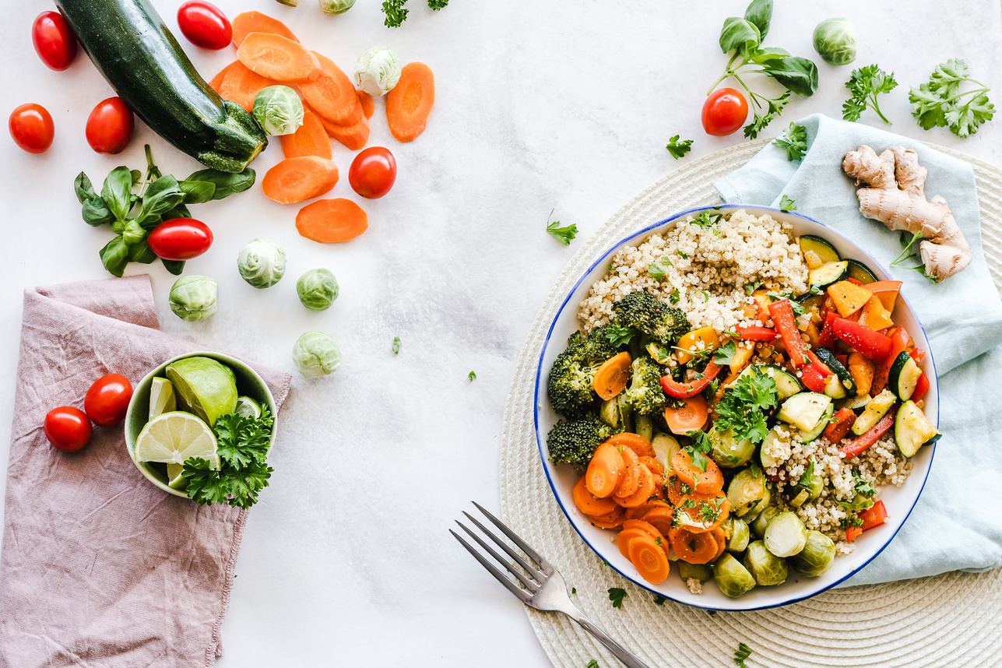
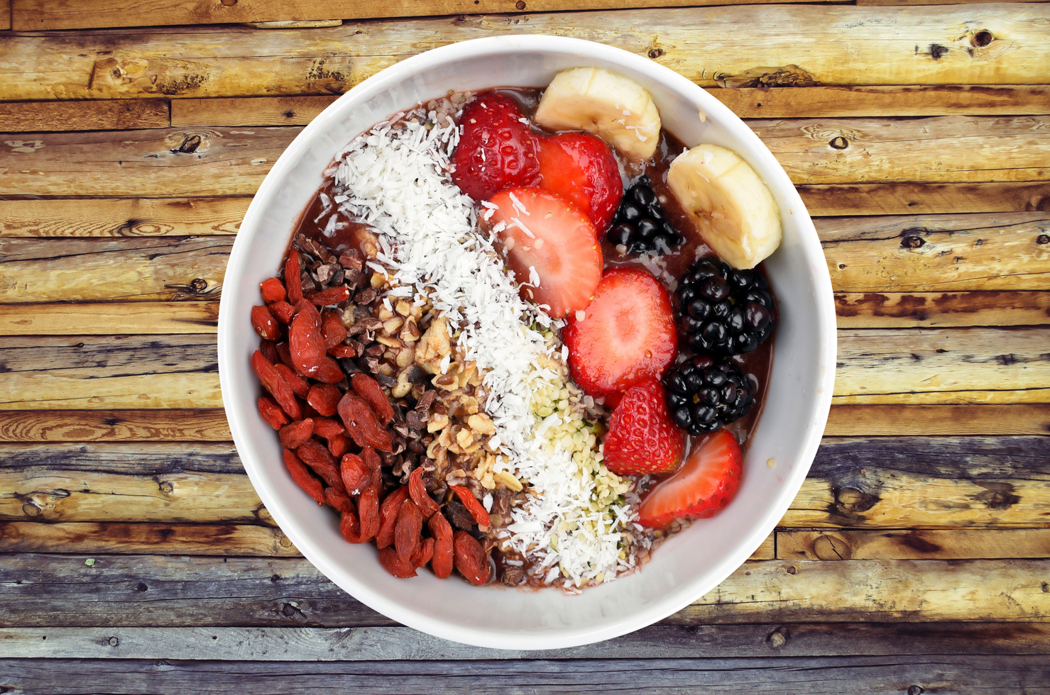

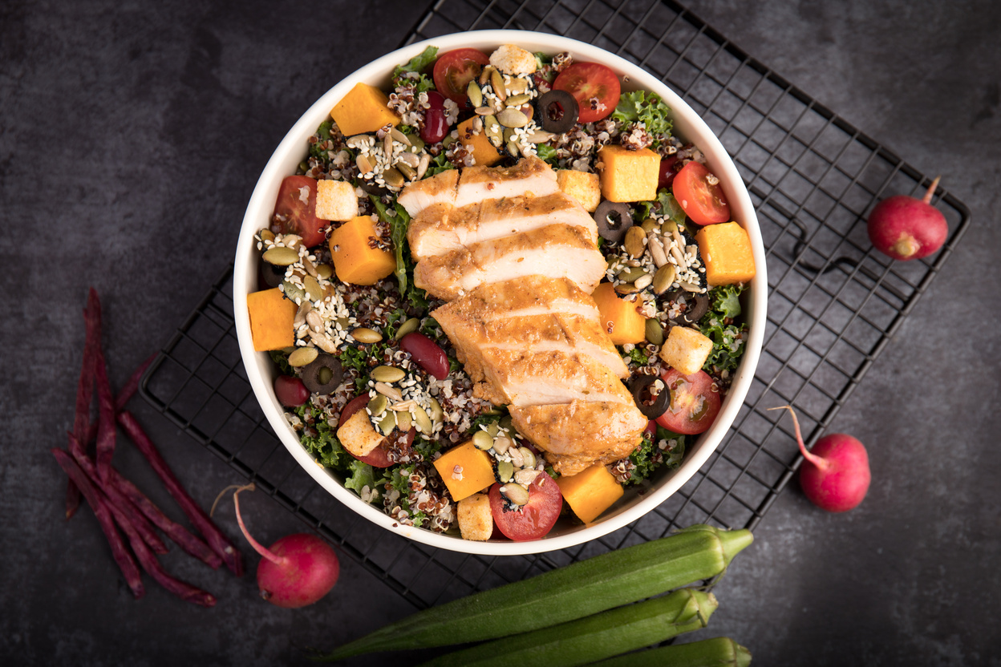


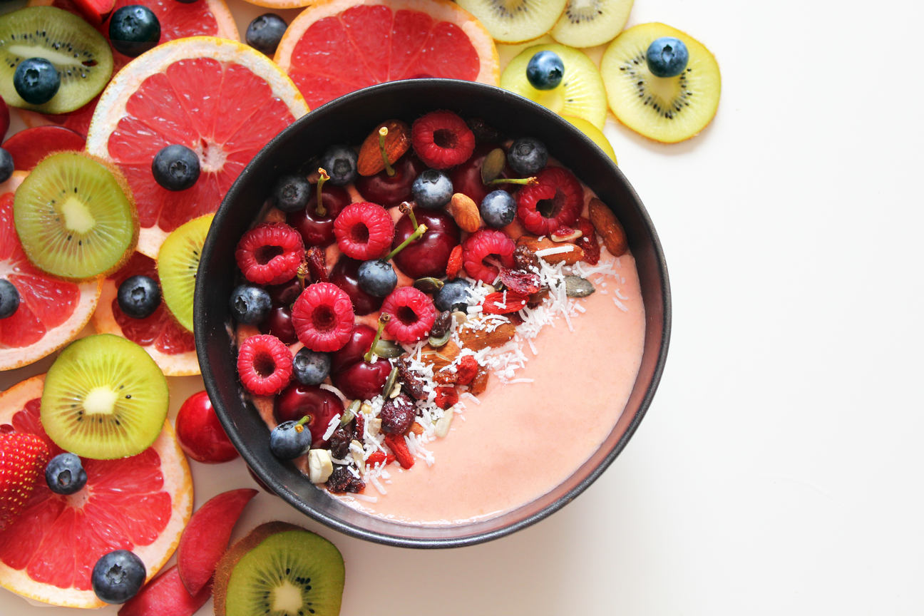
Content
1.Introduction to the project
2.Problem Statement
3.Objectives of the project
4.Requirements of the system (Hardware, software)
5.Implementation
6.Literature Survey
7.References

Slide 4

Introduction
Nibbles: a cool food app made with Flutter that helps you find yummy meals and snacks easily. It uses special tricks to make sure everything works smoothly and updates in real time. With Nibbles, you can search for food, scan QR codes for info, make a list of your favorite foods, and even choose filters to find exactly what you want. It also works nicely on different devices, and it's safe and easy to use. So, why not give Nibbles a try and explore delicious foods today?

Slide 5






problem statement
Current food delivery apps are not user-friendly for exploring various meals and packages.
Slow performance and outdated information result from inefficient state management.
Lack of essential features like robust search and QR code scanning hampers user experience.

Slide 6



objective of the project
The objective of Nibbles is to offer a smooth and engaging user experience for discovering a range of meals and snacks. This involves real-time updates, intuitive search features, and QR code scanning for quick information access. Nibbles also aims to personalize user experiences with favorite lists and filters, ensuring compatibility across devices, prioritizing safety, and driving user engagement and adoption.

Slide 7




requirements of the project
Development Machine:
- Processor: Intel Core i5 or equivalent.
- RAM: Minimum 8 GB, recommended 16 GB.
- Storage: At least 10 GB free space.
Internet Connection:
- Stable connection required for online resources and Firebase services.
User Devices:
- Mobile Devices: Compatible with modern iOS and Android.
- Screen Resolution: Supports various resolutions.
- GPS Module: Enables accurate location-based features.
- Flutter SDK for app development.
- Development environments like Android Studio or Visual Studio Code.
- Compatible operating systems (Android, iOS) for app installation.
- Internet connectivity for Firebase services and notifications.
- Necessary plugins/extensions for Flutter.
- Firebase Firestore for real-time data storage.
- Firebase Authentication for user authentication.
Hardware Requirements
Software Requirements

Slide 8

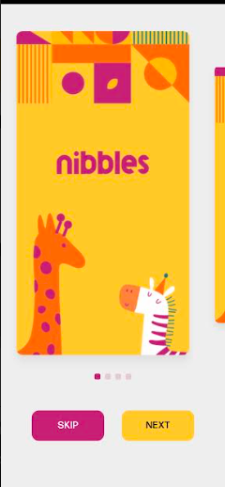


implementation

Slide 9
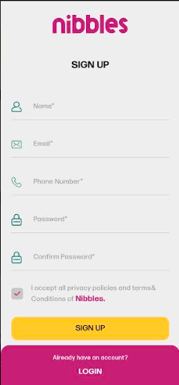
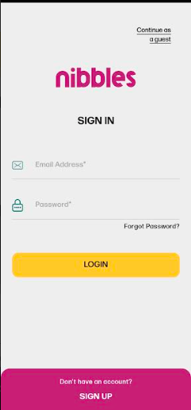
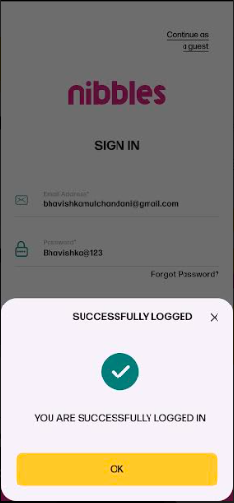

implementation

Slide 10

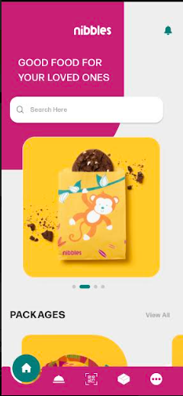
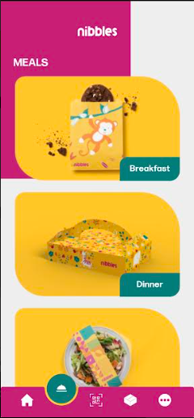

implementation

Slide 11
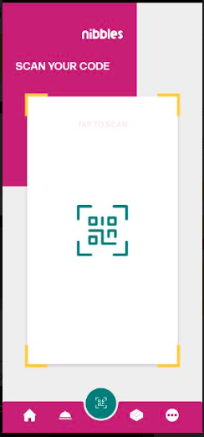
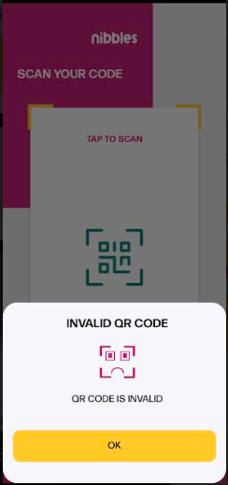
implementation

Slide 12
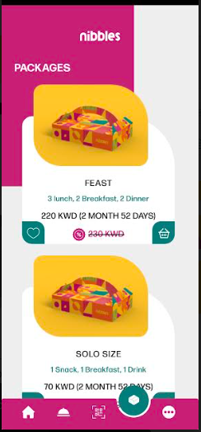
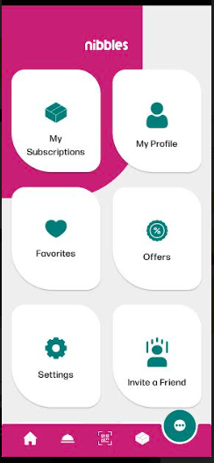
implementation

Slide 13

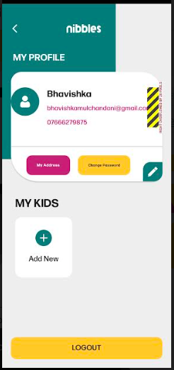
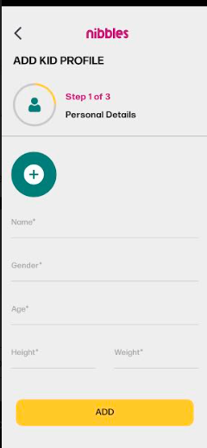
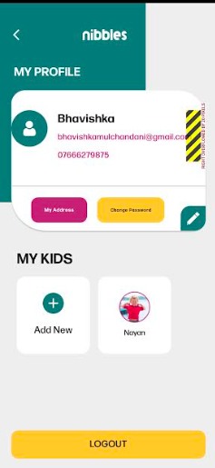

implementation

Slide 14
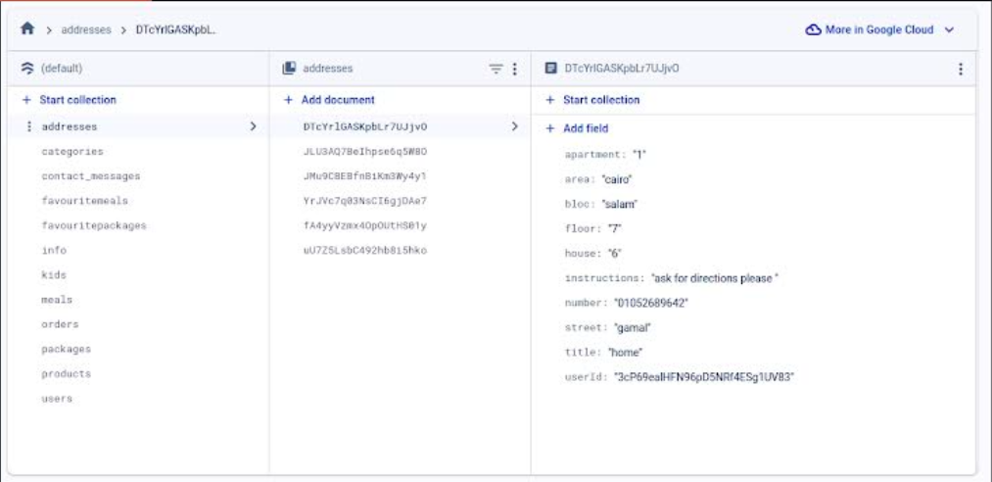
implementation

Slide 15
Literature Survey
Sr. No. | Title | Author(s) | Publish Date | Description
1. | FlutterEats: Building a Food Delivery App with Flutter | John Johnson | October 2019 | Learn to create FlutterEats, a food delivery app prototype, covering UI design, Firebase integration, authentication, and state management with Provider.
2. | FlutterFood: A Cross-Platform Food Ordering App | Amy Brown | September 2020 | Discover FlutterFood, a cross-platform food ordering app, exploring its architecture with Bloc pattern, Firebase integration, and insights for building similar apps with Flutter
3. | CookingPal: A Flutter-Based Cooking Companion App | Michael Wilson | December 2021 | Overview of CookingPal, a Flutter app for recipes, meal planning, ingredient scanning, and user profiles, inspiring cooking-related app development.

Slide 16




conclusion
Nibbles is a user-friendly food app built with Flutter, offering seamless features like advanced search, QR code scanning, and personalized lists. With its easy-to-use interface and integration of modern technologies like Firebase, Nibbles simplifies the process of exploring and enjoying delicious meals and snacks.

Slide 17
references
K. K. V. Jeongeun Lee, "Local Foodie: Experience Design of a Mobile Augmented Reality Application for Tourists to Encourage Local Food Consumption", pp. 1-2, 2020.
C. Bratianu, D. F. Stanescu and R. Mocanu, "Exploring the knowledge management impact on business education", Sustain., vol. 13, no. 4, pp. 1-16, 2021.
A. Ferraris, A. Mazzoleni, A. Devalle and J. Couturier, "Big data analytics capabilities andknowledge management: impact on firm performance", Manag. Decis., vol. 57, no. 8, pp. 1923-1936, 2019.

Slide 18
Thank you!

Slide 19
Vivekanand Education Society’s Institute Of Technology Department Of Information Technology
PWA
Presented by Bhavishka Mulchandani
Roll no:40 Div:D15B
Batch:B
Guided By-
Dr. Ravita Mishra

Slide 20
Features
Add to Home Screen: This feature allows users to save a PWA to their device's home screen with an icon, similar to native apps. Once added, the PWA can be launched directly from the home screen, providing a full-screen experience without the browser UI, thereby enhancing user engagement and ease of access.
Service Worker Events: Fetch, Sync, Push: - Fetch: Intercept network requests to cache or retrieve assets, enabling offline use or faster load times. - Sync: Delay actions until a stable internet connection is available, useful for posts or updates made offline. - Push: Receive push notifications from a server, even when the browser is closed, keeping users engaged with timely content or alerts.
Upload Product: This features allow the user to upload their product which they want to sell on the site .
Whatsapp/call seller : Connects with the dealer through whatsapp or phone number to purchase the product.

Slide 21
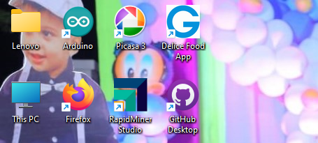
Homescreen icon
Website added to
homescreen

Slide 22
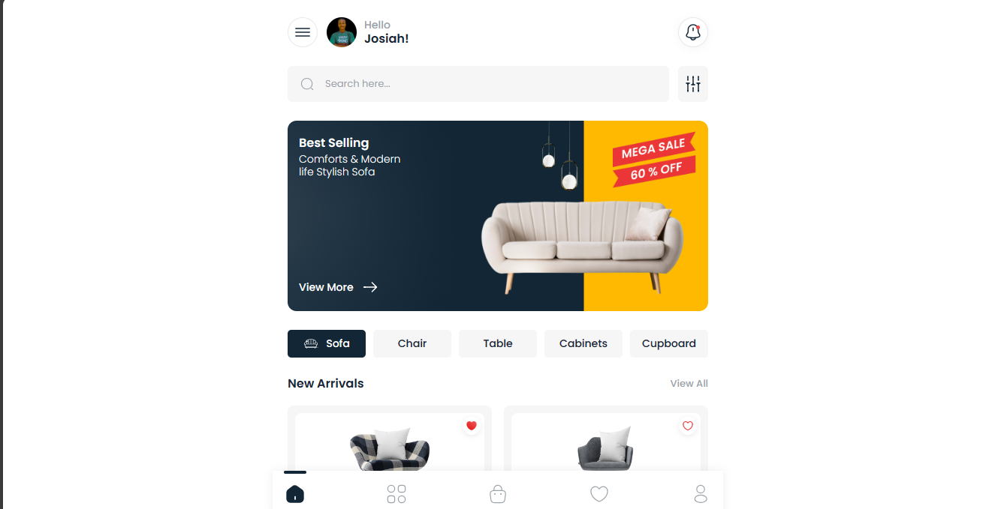
homepage

Slide 23
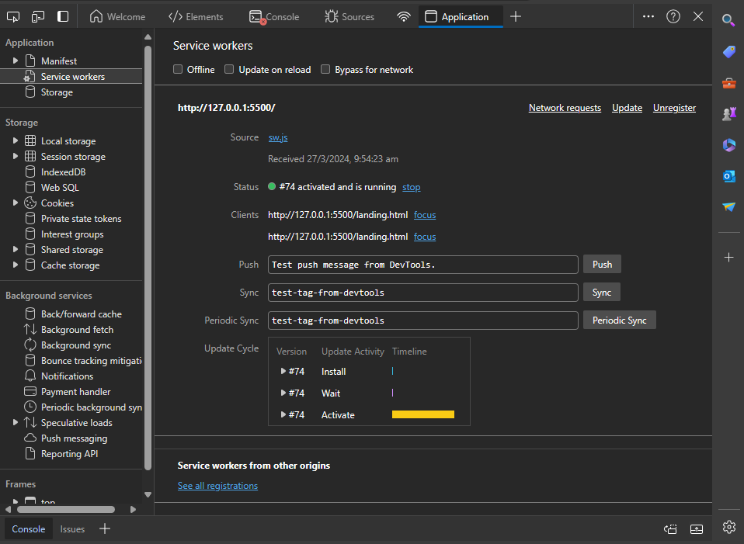
pwa features

Slide 24
references
K. K. V. Jeongeun Lee, "Local Foodie: Experience Design of a Mobile Augmented Reality Application for Tourists to Encourage Local Food Consumption", pp. 1-2, 2020.
C. Bratianu, D. F. Stanescu and R. Mocanu, "Exploring the knowledge management impact on business education", Sustain., vol. 13, no. 4, pp. 1-16, 2021.
A. Ferraris, A. Mazzoleni, A. Devalle and J. Couturier, "Big data analytics capabilities andknowledge management: impact on firm performance", Manag. Decis., vol. 57, no. 8, pp. 1923-1936, 2019.

Slide 25
Thank you!

